Slide 1

What is a Digital Twin?
Dr Vinny Davies
Lecturer in Statistics, University of Glasgow

Slide 2
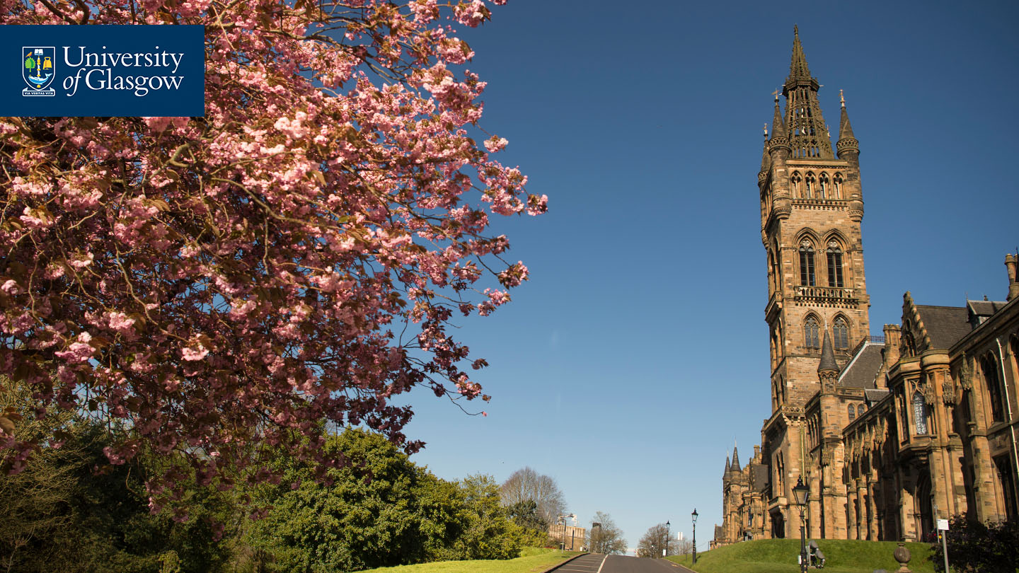
About the University
Established in 1451
Ranked in the top 100 of the world’s universities
Ranked 13th in the world in the QS World Sustainability Rankings and the THE Impact Rankings
Member of the Russell Group of research-intensive UK universities
Eight Nobel Laureates connected to the University

Slide 3
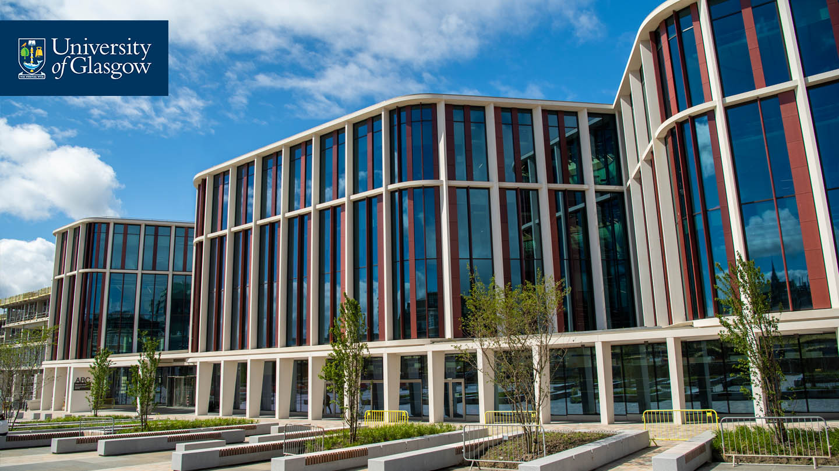
The Advanced Research Centre (ARC) & The Centre for Data Science and AI
Wide variety of researchers across the university in almost anything you can think of. Computational methods from statistics and machine learning are developed across the campus.

Slide 4
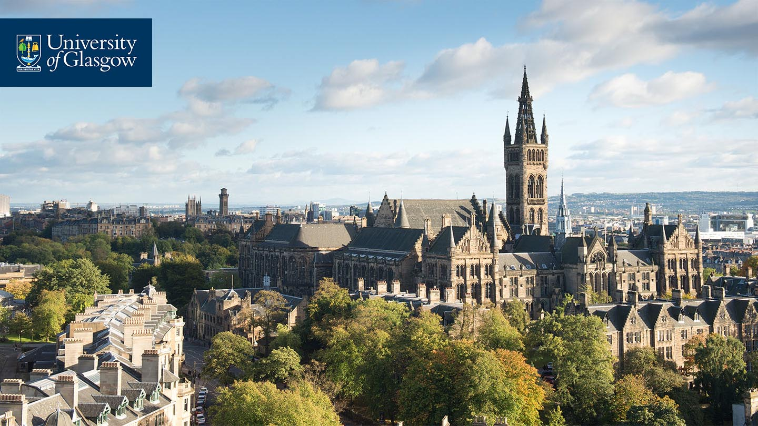
School of Mathematics and Statistics
Our school contains around 30 Statisticians researching across a variety of subjects, including 6 professors.
Large environmental statistics group and expanding expertise in Machine Learning and AI
Active collaborations with National Grid, SSE, The World Health Organisation, Shell, SEPA. Scottish Water, CENSIS, and many more

Slide 5
Quick bit about me
Dr Vinny Davies, Lecturer in Statistics
Fellow of Royal Statistical Society (RSS) and RSS Mardia prize winner (2021). Member of the RSS Computational Statistics and Machine Learning committee
Expertise in computational statistics and machine learning with an emphasis on having an impact rather than developing theory
My current research interests focus on Digital Twins with applications in metabolomics, cardiac mechanics, aquaculture, biodiversity and carbon emissions (with NatWest)

Slide 6
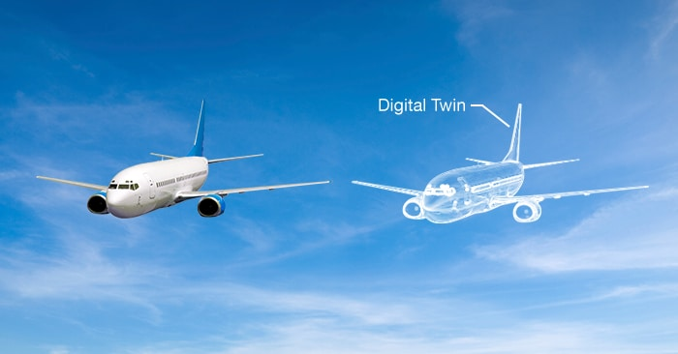
What is a Digital Twin?
A digital twin is essentially a digital replica of some real-life process
Generally, the digital twin will be a computerised version of the real-life process that allows us to simulate the process and understand what happens in different situations

Slide 7
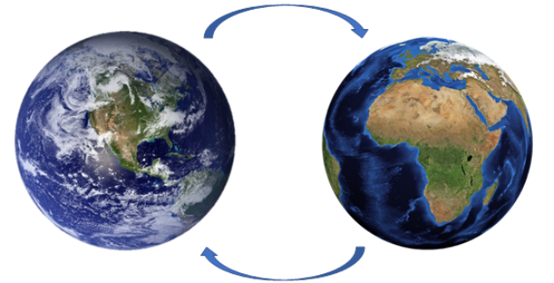
A Digital Earth
The concept of a Digital Earth is an extreme example of a Digital Twin
A Digital Earth is a digital twin of the Earth which would allow us to understand the effects of global warning or potentially the environmental footprint of business

Slide 8
Environmental Digital Twins
More realistically a digital twin might represent a smaller system such as say a river or a city
River twin may include flooding, biodiversity, and pollution
City twin might include traffic, air quality, and pedestrians
Alternatively, a digital twin might just focus one particular element, e.g., flooding, weather, biodiversity
Each model could then be used to help several different applications

Slide 9
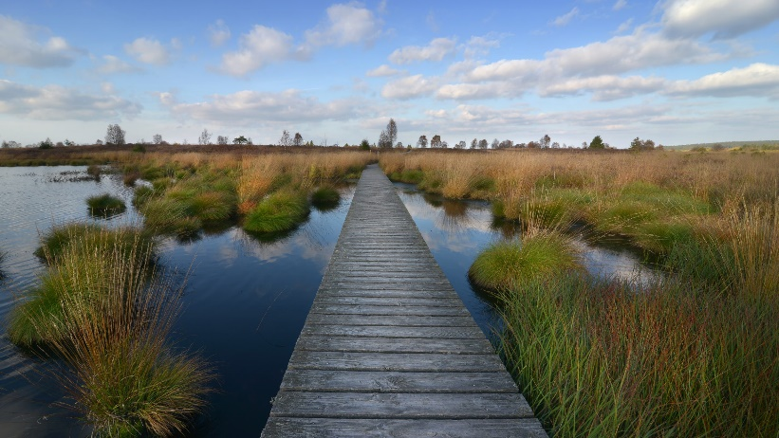
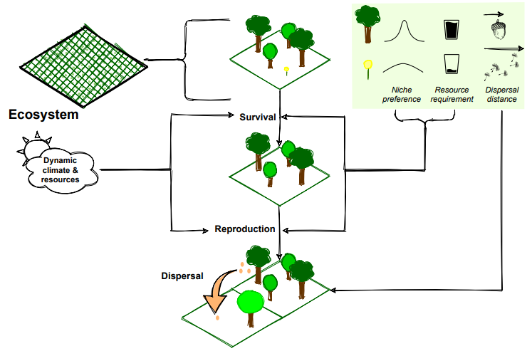
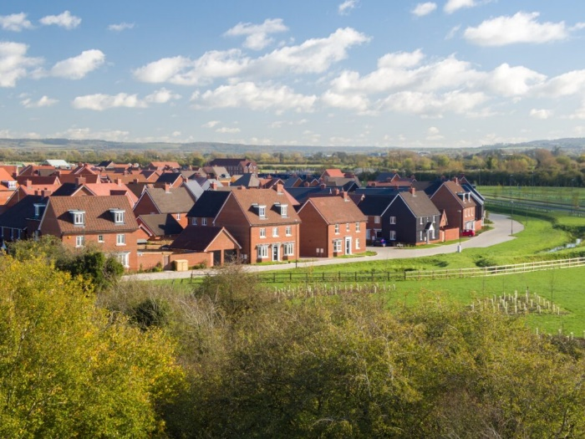
Environmental Digital Twins
Take a digital twin for biodiversity
Academics might use it to understand peatland regeneration
NatWest might use it to understand a business’ climate footprint
Peatland regeneration
EcoSISTEM Digital Twin
https://arxiv.org/pdf/1911.12257.pdf
New housing effecting biodiversity

Slide 10


So, what actually is a Digital Twin?
Digital Twin
Real System

Slide 11
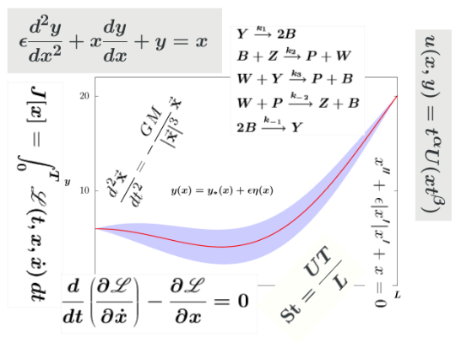
So, what actually is a Digital Twin?
Physical Model
Digital Twin
Real System

Slide 12
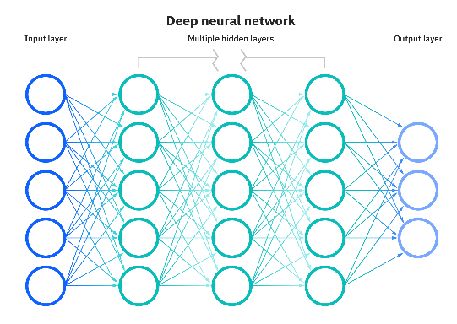
So, what actually is a Digital Twin?
ML / AI Model
Digital Twin
Real System

Slide 13

So, what actually is a Digital Twin?
Digital Twin
Real System
Code

Slide 14
So, what actually is a Digital Twin?
Physical Model
ML / AI Model
Digital Twin
Real System
Code

Slide 15
So, what actually is a Digital Twin?
Digital Twin
Physical Model
ML / AI Model
Digital Twin
Real System
Code

Slide 16
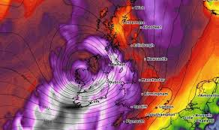
So, what actually is a Digital Twin?
Weather Data
Digital Twin
Physical Model
ML / AI Model
Digital Twin
Code

Slide 17
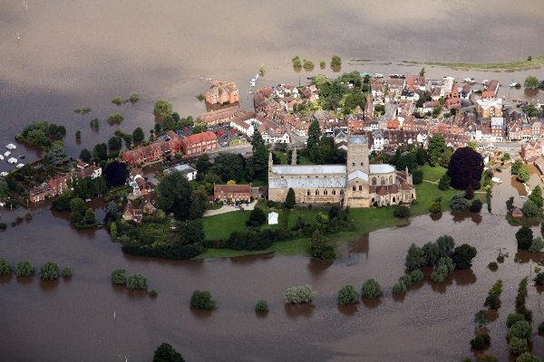
So, what actually is a Digital Twin?
Weather Data
Digital Twin
Physical Model
Flooding Data
ML / AI Model
Digital Twin
Code

Slide 18
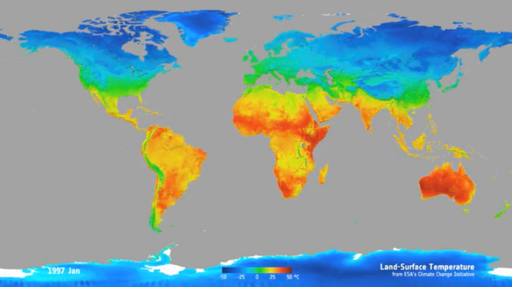
So, what actually is a Digital Twin?
Weather Data
Digital Twin
Physical Model
Flooding Data
ML / AI Model
Temperature Data
Digital Twin
Code

Slide 19
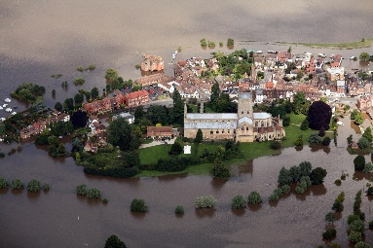

So, what actually is a Digital Twin?
Data
Digital Twin
Physical Model
ML / AI Model
Digital Twin
Code

Slide 20
So, what actually is a Digital Twin?
Training models and parameters
We can use the combination of our digital twin and available data to train the models and parameters of the digital twin
Data
Digital Twin
Physical Model
ML / AI Model
Digital Twin
Code

Slide 21
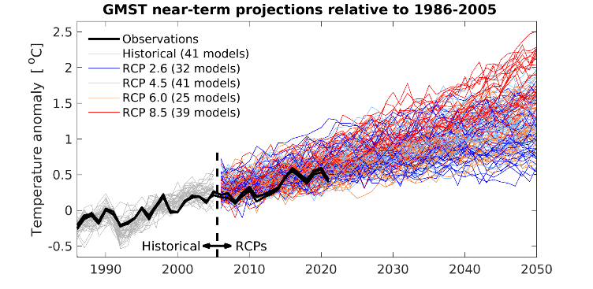
So, what actually is a Digital Twin?
Training models and parameters
We can use the combination of our digital twin and available data to train the models and parameters of the digital twin
Data
Digital Twin
Physical Model
ML / AI Model
Scenario Planning
Digital Twin
Code

Slide 22
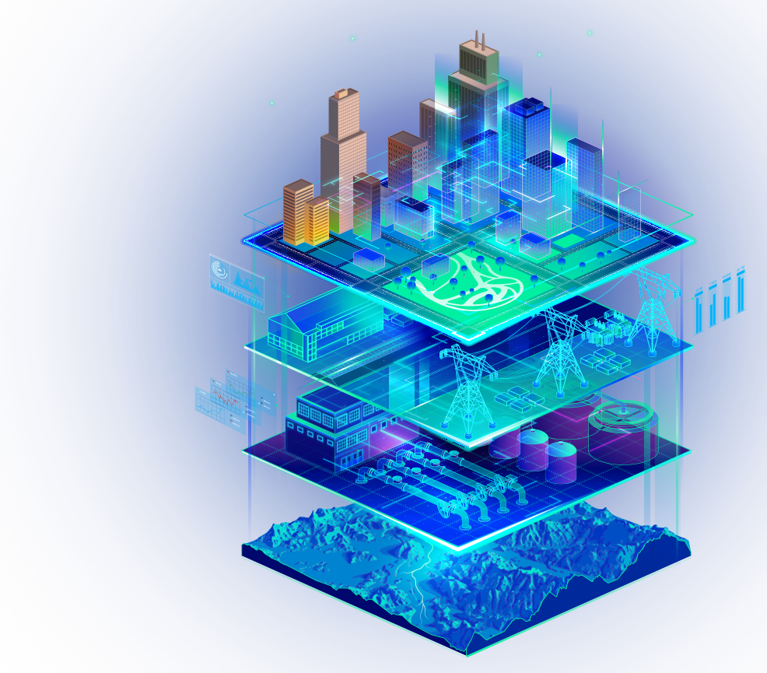
So, what actually is a Digital Twin?
Practically, a large digital twin will be a combination of multiple existing digital twins
Data may potentially link to some parts of the digital twin but not others
How to combine these is one of the major current challenges related to digital twins
Similarly, how to link data effectively to the digital twins

Slide 23
How can we use Digital Twins?
Inference
Learn something about our real system
Example: understand how a house’s EPC affects energy use
Scenario Planning
Learn how our real system is affected by different future scenarios
Example: how does climate change affect biodiversity?
Tool / Intervention Development
Design new tools or interventions that could be implemented in the future
Example: how does installing solar panels affect carbon emissions?

Slide 24
Inference
Training models and parameters
We can use the combination of our digital twin and available data to train the models and parameters of the digital twin
Data
Digital Twin
Physical Model
ML / AI Model
Digital Twin
Code

Slide 25
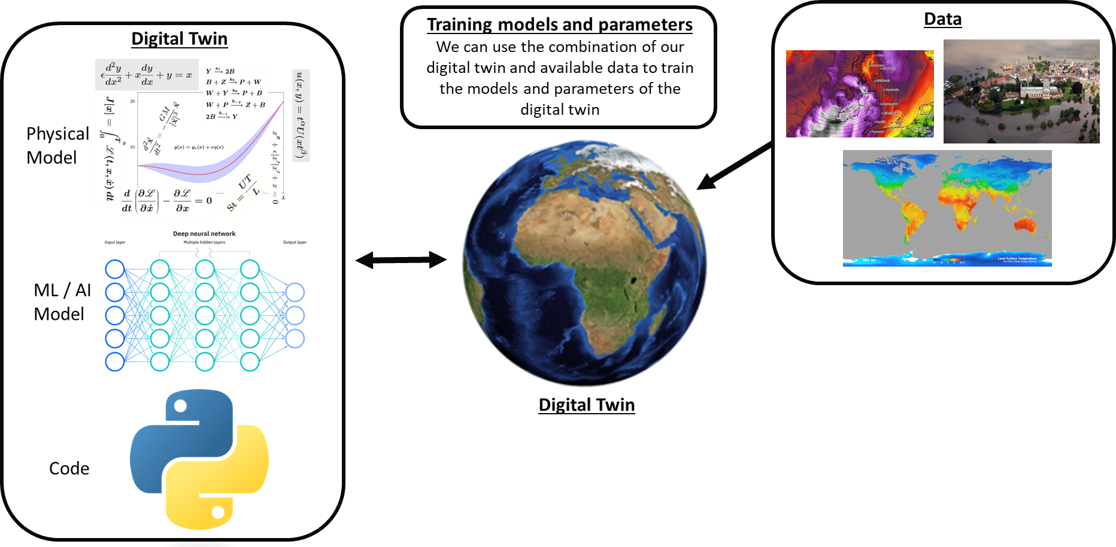
Inference
Inference process
Take our digital twin
Link the data
Infer models and parameters
Learn information about your real system
Useful when a system is complex, e.g., needs multiple models, OR when complex physical models can be used, e.g., physics models for weather
Models can be either trained individually or as one (potentially much more complex)

Slide 26
Scenario Planning
Training models and parameters
We can use the combination of our digital twin and available data to train the models and parameters of the digital twin
Data
Digital Twin
Physical Model
ML / AI Model
Scenario Planning
Digital Twin
Code

Slide 27
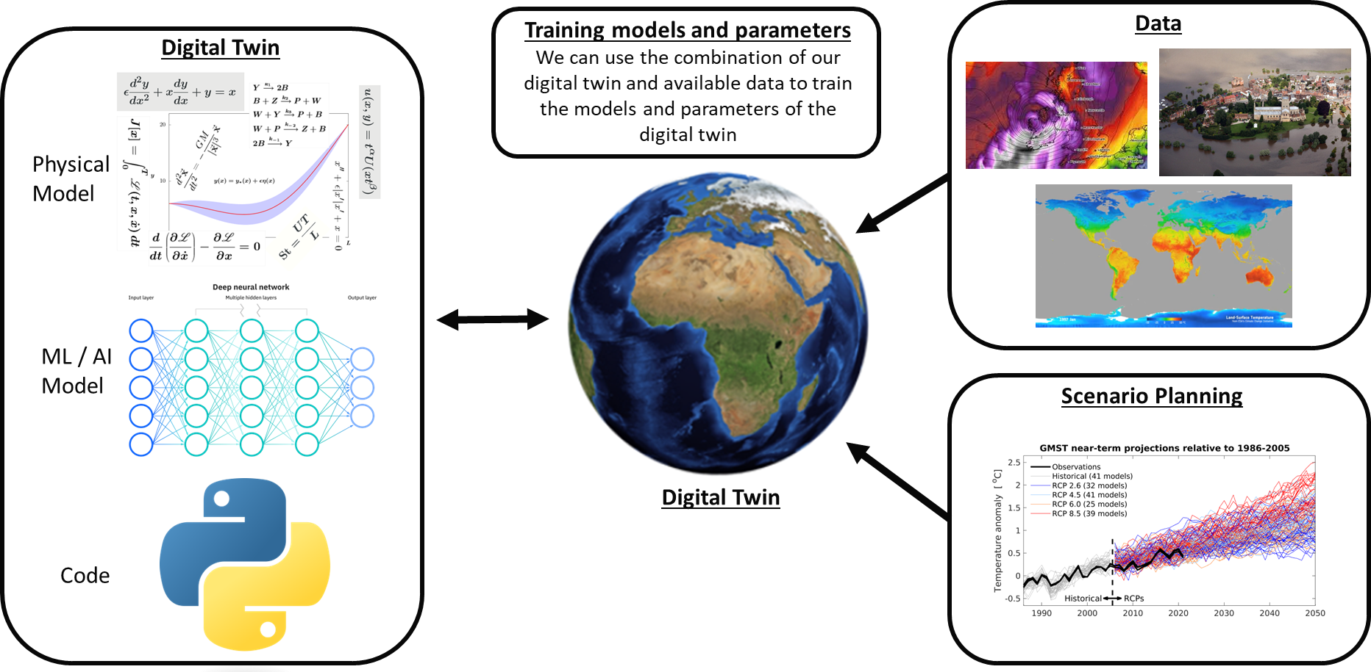
Scenario Planning
Complete the inference process
Run forward simulations
Quantify uncertainty
Difficulty in how to best run the simulations
Potentially easier in a climate change scenario where you might have a model with uncertainty
More difficult with energy usage – would need to run different scenarios under different assumptions of infrastructure construction (Nuclear power plants, wind turbines), government policy, installation of batteries, solar panels etc.
Much more difficult to accurately quantify uncertainty here

Slide 28
Tool / Intervention Development
Training models and parameters
We can use the combination of our digital twin and available data to train the models and parameters of the digital twin
Data
Digital Twin
Physical Model
ML / AI Model
Scenario Planning
Digital Twin
Code

Slide 29
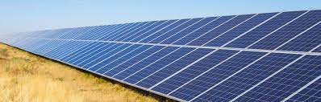
Tool / Intervention Development
Training models and parameters
We can use the combination of our digital twin and available data to train the models and parameters of the digital twin
Data
Digital Twin
Physical Model
ML / AI Model
Scenario Planning
Digital Twin
Tool / Intervention
Code

Slide 30
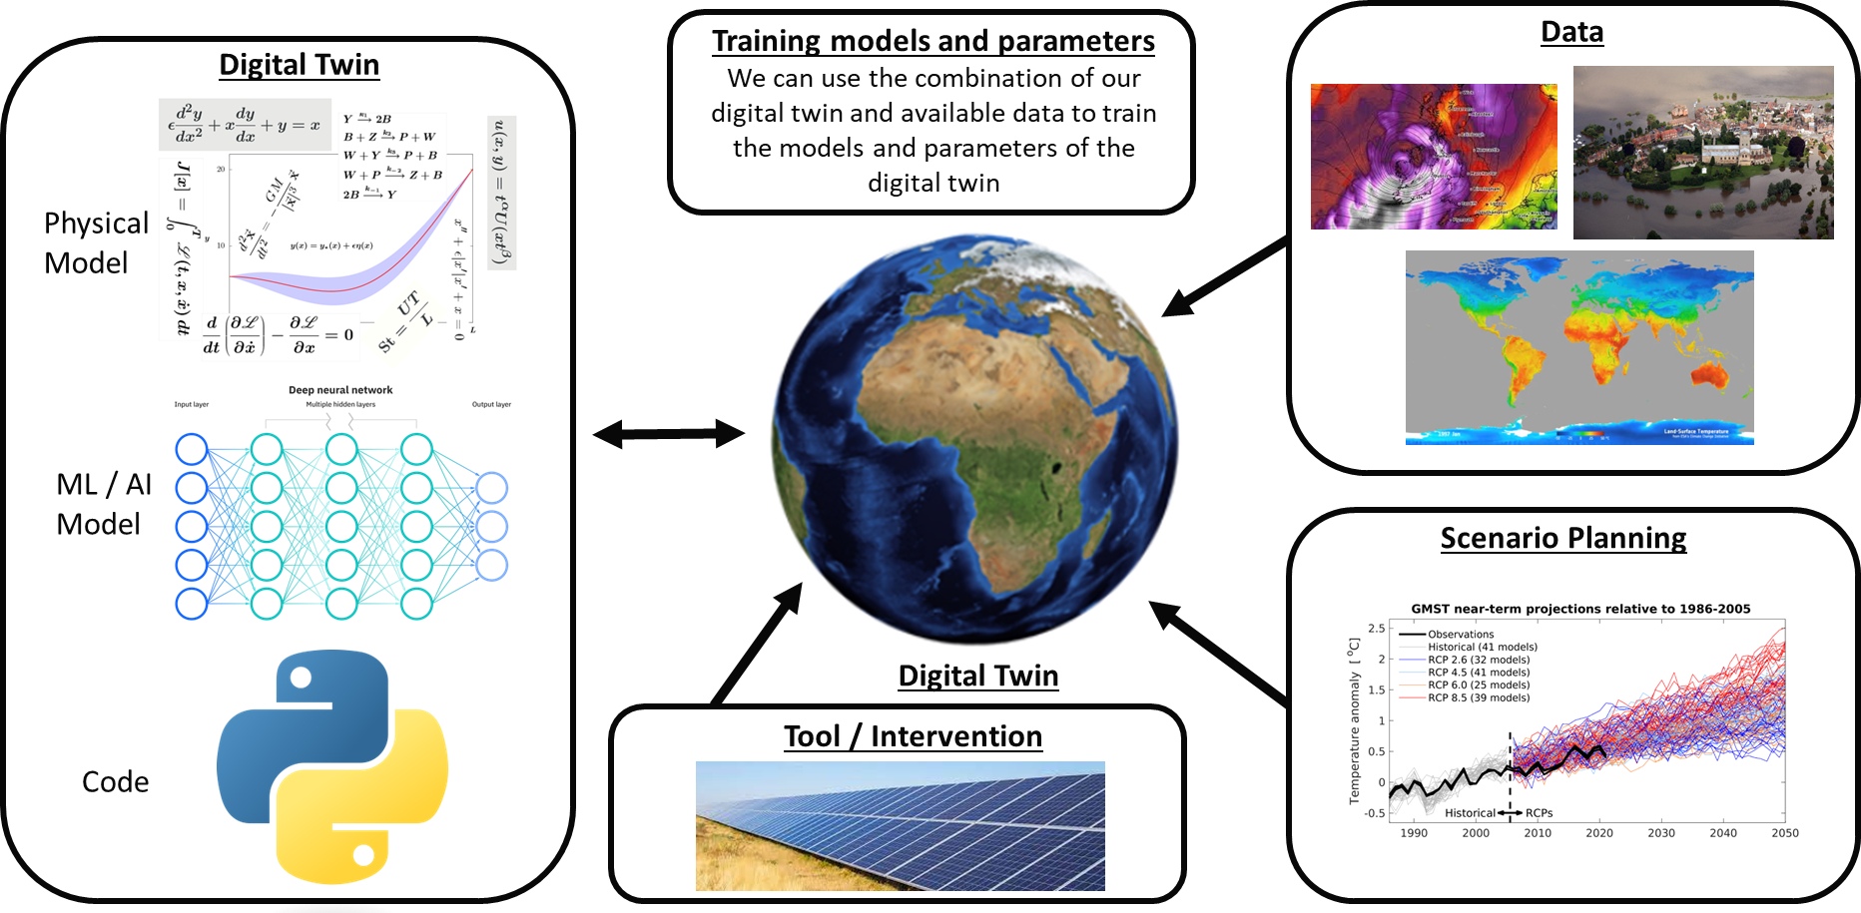
Tool / Intervention Development
Need data on proposed intervention
Need assumptions on how tool would be used
Combine with inference and scenario planning to understand the effects of changes
Test different interventions / policies under different scenarios

Slide 31
Example of Digital Twins
Digital twins have been used across almost every field
I’ll try to give a few examples that might be relevant to NatWest’s interests

Slide 32
Biodiversity Digital Twins
At the University of Glasgow there is ongoing work on a plant biodiversity digital twin
EcoSISTEM simulates plant life, helping to understand the effects of climate change and local decision-making processes
There is a large biodiversity Digital Twin being developed in Europe as well
https://arxiv.org/pdf/1911.12257.pdf

Slide 33
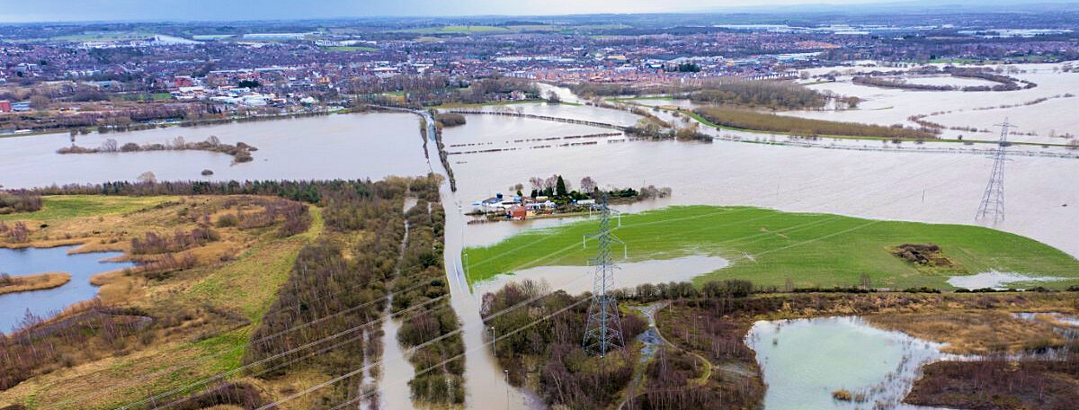
Climate Resilience Demonstrator (CReDo)
The CReDo digital twin looks at resilience to flooding for energy, water, and telecoms networks
Essentially it helps identify causal vulnerabilities in systems
If one think goes wrong, what will happen
What are the probabilities of these things happening?
How does one decision effect another
https://digitaltwinhub.co.uk/credo/credo/

Slide 34

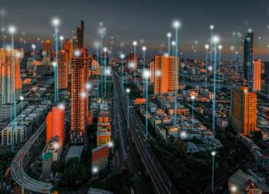
Virtual Energy System
Network of Digital Twins by the National Grid
To help plan the journey to Net Zero and a carbon free future
Governance structure and stakeholder engagement
https://www.nationalgrideso.com/future-energy/virtual-energy-system

Slide 35

Joint UK Land Environment Simulator (JULES)
JULES is a community land surface model
Has models for hydrology, soil, and vegetation

Slide 36

Met Office Unified Model (UM)
UM is a numerical model of the atmosphere for weather and climate applications
Built on complete mathematical models for the atmosphere and weather

Slide 37

Land Insight digital twin
A digital twin for UK soils
Links with other digital twins
Combines a variety of different types of measurements

Slide 38

Challenges with Environmental Digital Twins
Effective data collection
Fusing data sources
Joining digital twins
Uncertainty quantification
Understanding stakeholders
Identifying co-benefits
Most of these apply more generally when making environmentally motivated policies and products

Slide 39
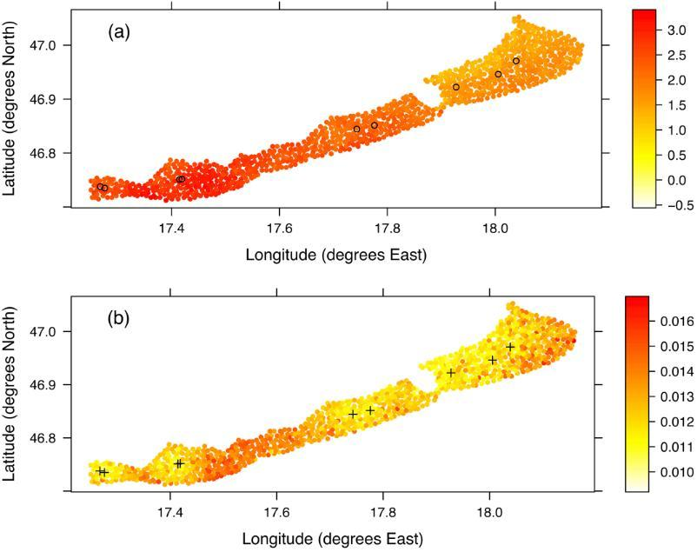
Effective Data Collection
What kind of data should we collect or buy?
High-quality, low-resolution vs low quality, high resolution
Customer data or more general data?

Slide 40
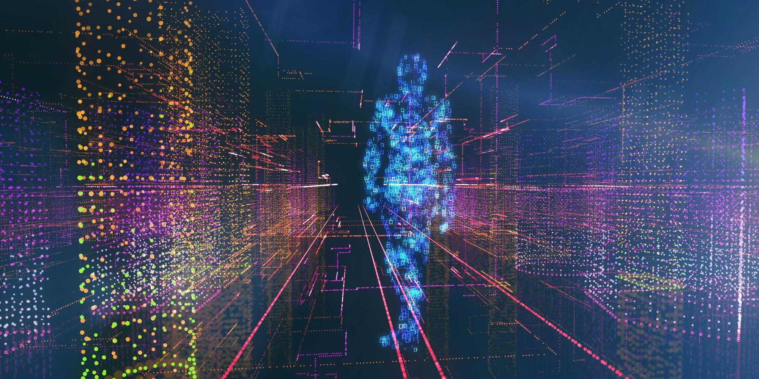
Fusing Data Sources
How do we deal with different types of data?
How do we deal with data of different qualities?
How do we link data to models?

Slide 41
Joining Digital Twins
To create a large-scale digital twin of a system, we need to link existing models and digital twins together
Combining twins of different types (e.g., numerical, statistical) can be challenging
How do we set our digital twins up so they can be combined?

Slide 42
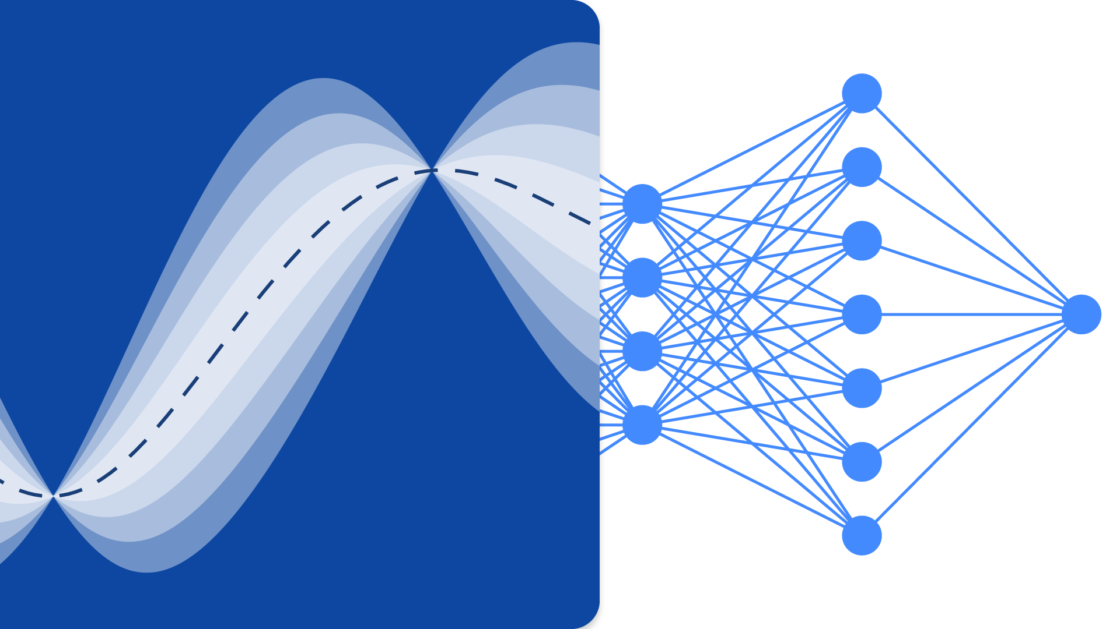
Uncertainty Quantification
How do we represent uncertainty correctly?
How do we propagate uncertainty throughout the digital twin?
How do we trade off different uncertainties across models and data?

Slide 43
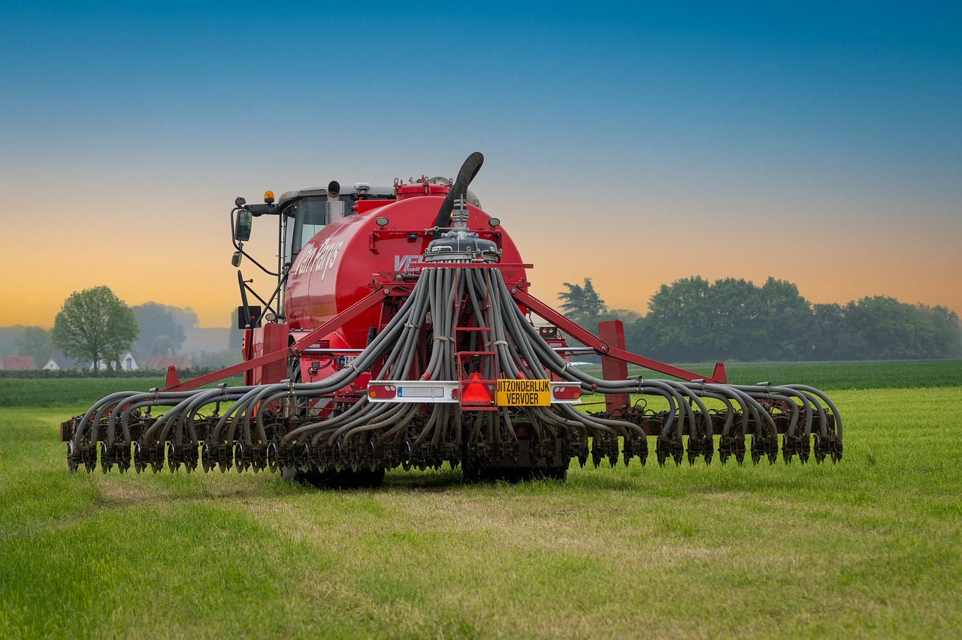
Understanding Stakeholders
How do we make sure digital twins / products are useful?
How do we convince stakeholders to engage with products and recommendations?

Slide 44
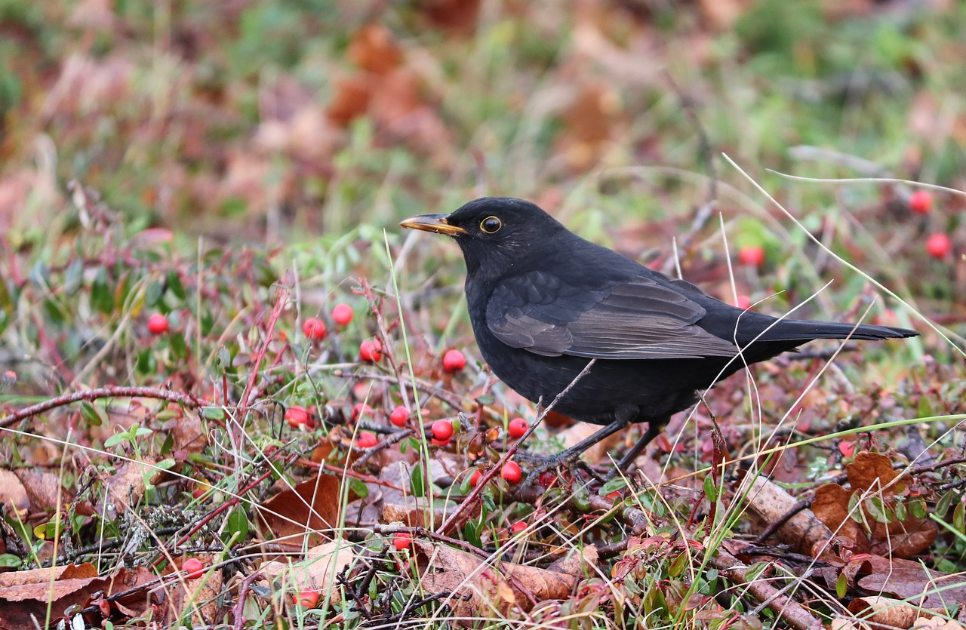
Identifying Co-Benefits
How do we identify additional benefits within digital twins?
How do we ensure those benefits are recognised?

Slide 45
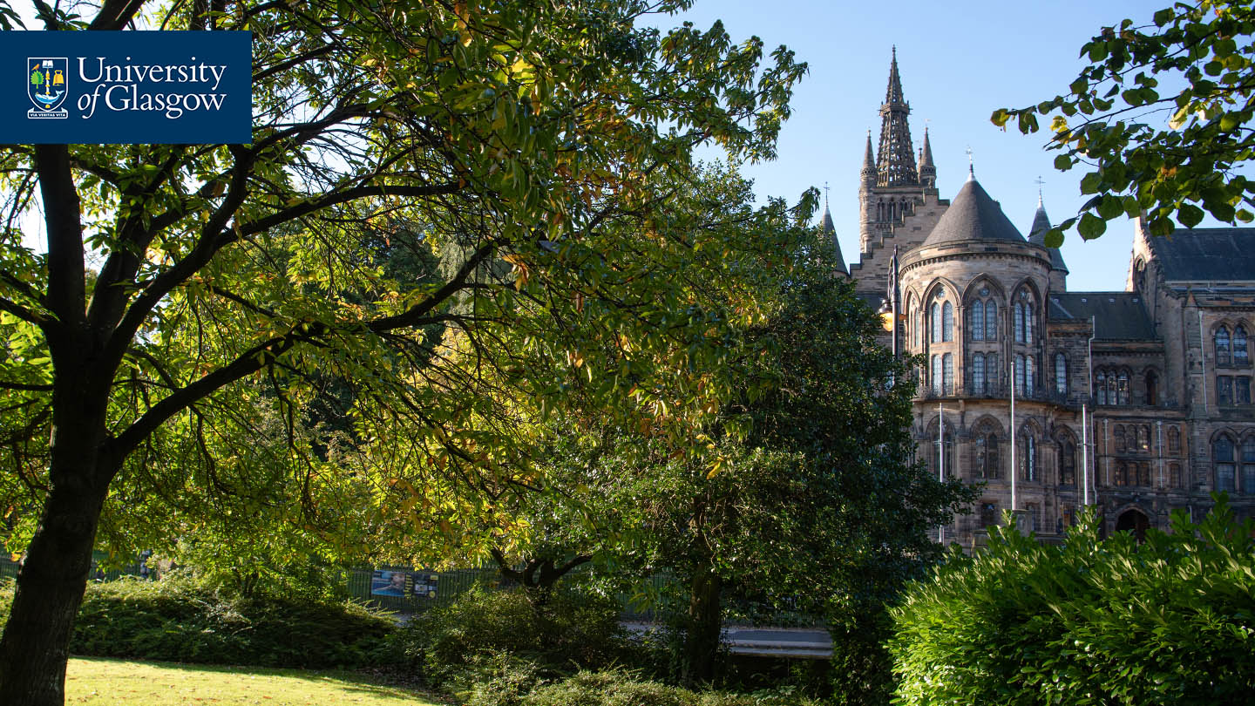
Opportunities at the University of Glasgow
The university and its funders are extremely keen on industry collaborations and have ways of providing funds to support this.
- PhD Students
- Impact Accelerator Account funding
- UKRI Collaborative calls
- Knowledge Transfer Partnerships
Events and seminars are also always happening at the university and are often open to all.

Slide 46
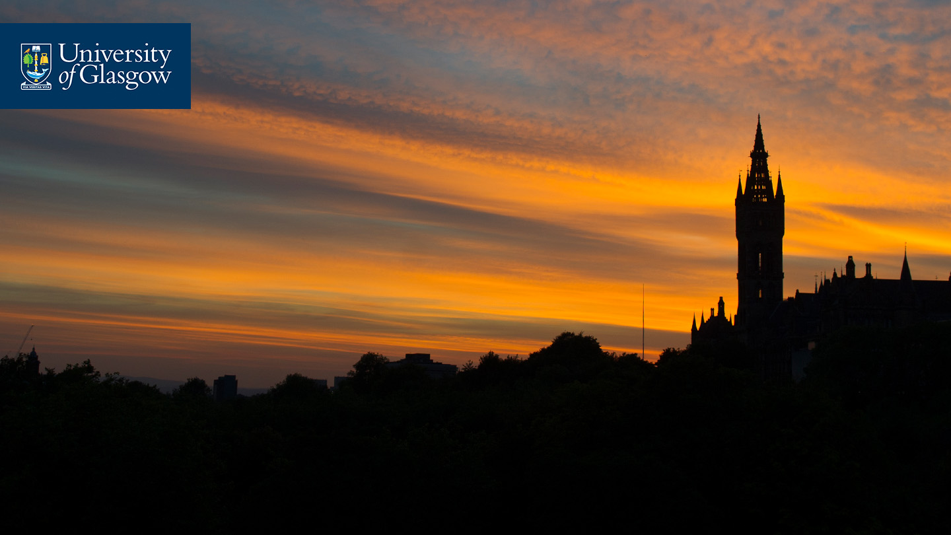



If you have any questions, then please feel free to ask. You can also contact me at Vinny.Davies@Glasgow.ac.uk Slides available at https://github.com/vinnydavies/presentations
#UofGWorldChangers
@UofGlasgow

